Slide 1
Introduction to Software Development
Week 2 Day 2
Led by: Emily Crose
for
Oakland University

Slide 2

Previous Session recap

Slide 3

Question or clarifications?

Slide 4
Terms To Listen For
Loops
Repeated routines
Nesting
A routine within another routine
Libraries
Pre-made, coded routines which we may utilize in our program

Slide 5
Programming Core Concepts
Source code
We develop the program’s source code. Our program will then run using these instructions
Program execution
The program’s operation is transferred to memory and runs
Routines
Processes that a program will execute
Compiling
Building an executable binary

Slide 6
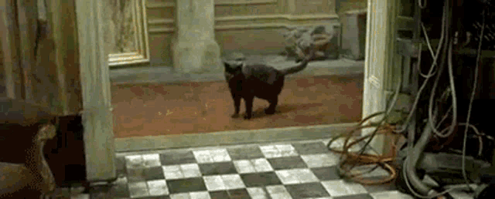
Notes:
Ultimately, a program is a set of instructions for something that we plan to do over and over again.

Slide 7

Manual vs. automation
Notes:
How do we decide when we need to automate something?

Slide 8
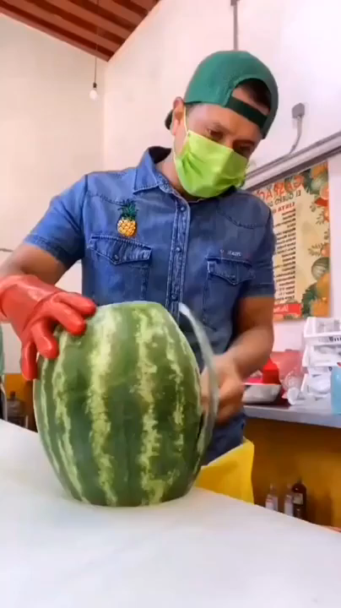
Notes:
In the world of computers, you can choose to do any given task one of two ways mainly. You can do things manually, and that might work just fine if all you need to do is a single task a single time. But at scale, it doesn’t matter how good you are at executing that task. At a certain point, automation will always make more sense.

Slide 9
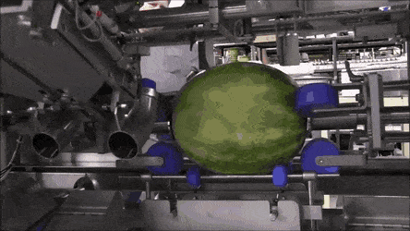

Slide 10

What is programming?
Notes:
Programming is our ability to give a computer a set of tasks that it can execute.

Slide 11
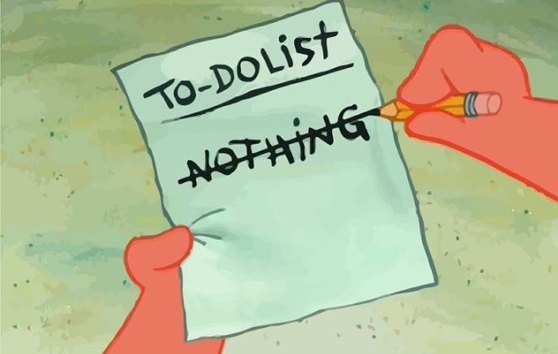
What is programming?
Notes:
All programming is ultimately is a list of instructions we want our computer to do. Granted, it tends to be a very complex and logically dense list of instructions, but they boil down to tasks that need to be done in sequence. Computers take in information, process it, and we end up with an output. Transformed information.

Slide 12

Organizing Program operations

Slide 13

Process flowchart
Notes:
We can also use flowcharts as a tool to outline the way that information is generated and processed by a system. Using tools like pseudocode and flowcharts can help build an idea of exactly how the program will do what it’s supposed to do.

Slide 14

“Pseudo”code
Notes:
The exercise of producing “pseudocode” can help solidify concepts into achievable actions which can be programmed and build as an application.

Slide 15
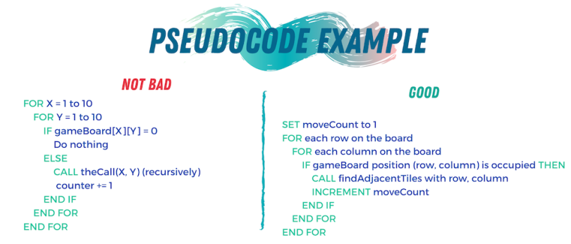
Pseudocode example

Slide 16
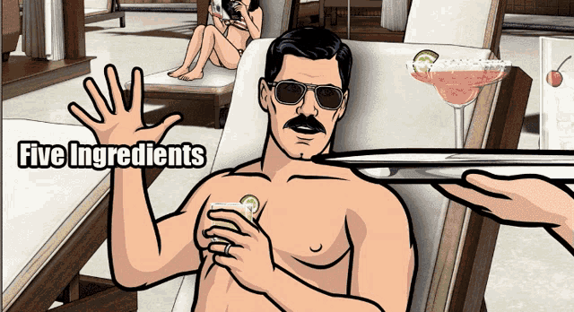
Dependencies

Slide 17
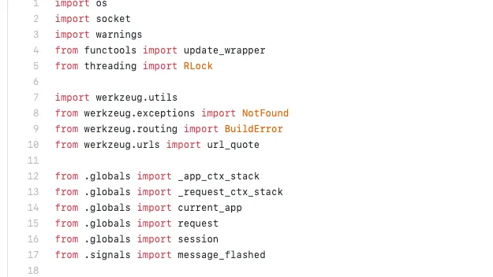
Python libraries as dependencies

Slide 18
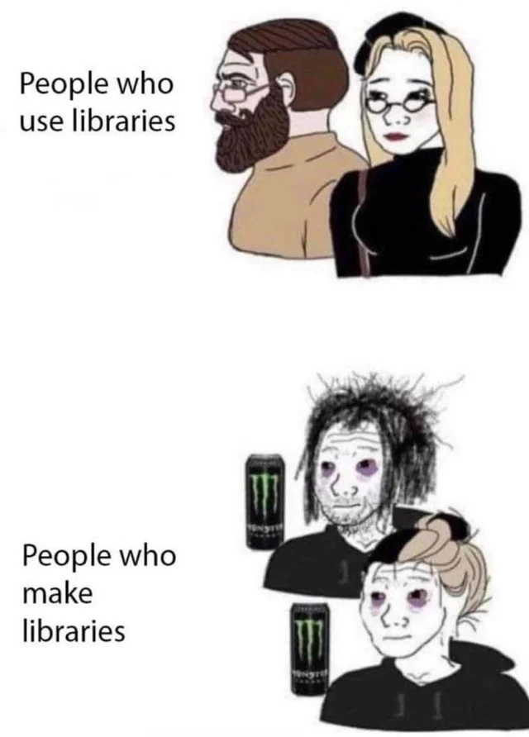
Libraries and you

Slide 19
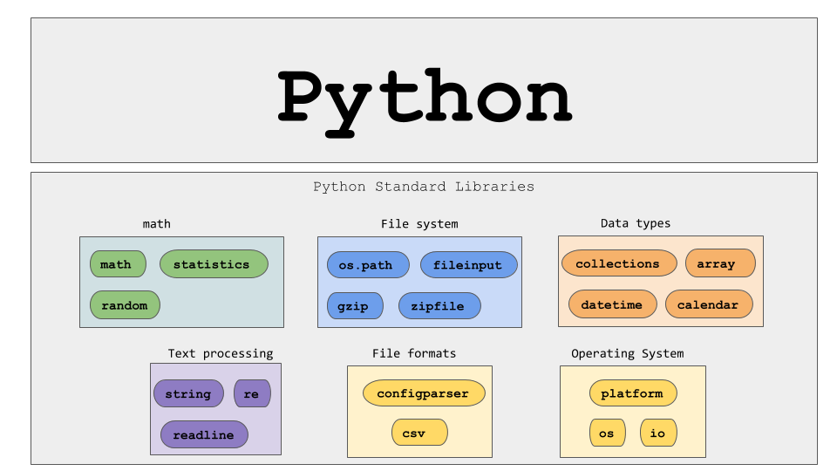

Slide 20

Software Bill Of Materials (SBOM)
Notes:
When it comes to software, you don’t want to be in a mystery box situation.

Slide 21

Program Facets

Slide 22
Boolean
Notes:
Boolean is the term we use to describe a logical proposition. We can use these in software development and electronics

Slide 23

Notes:
The ultimate aim of logical operators is to evaluate a statement as either true or false.

Slide 24
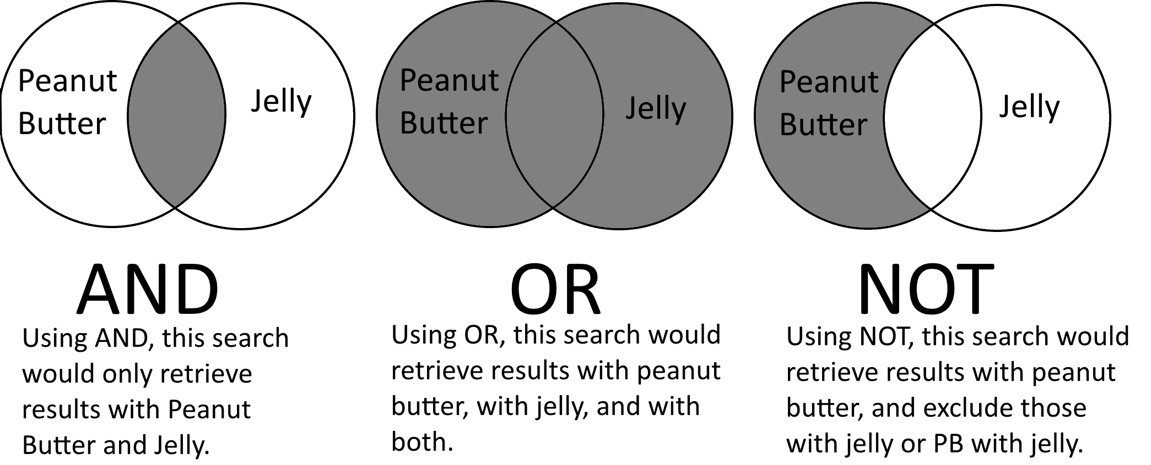
Logical Operations

Slide 25
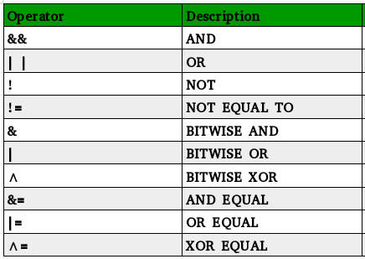
Notes:
This is a chart of some logical operators we may see in C++. Some of these also apply to python as well.

Slide 26
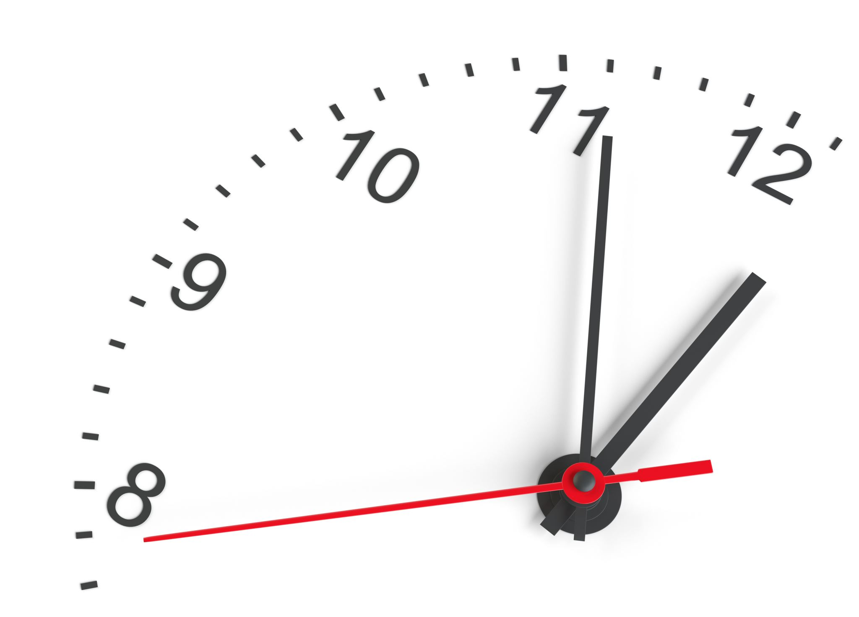
10 minute break

Slide 27
Variables
Notes:
Variables are items within our code which we can manipulate.

Slide 28
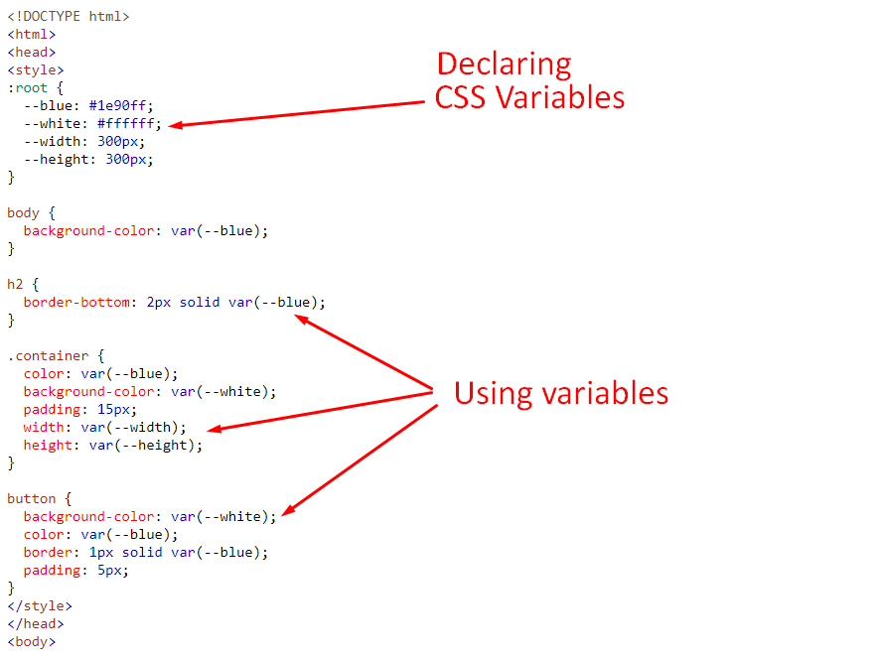

Slide 29
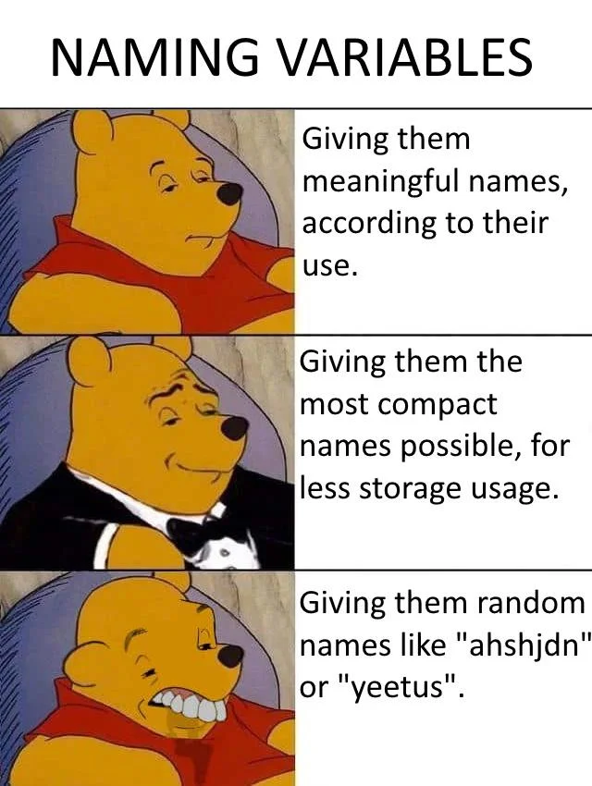

Slide 30

Loops

Slide 31
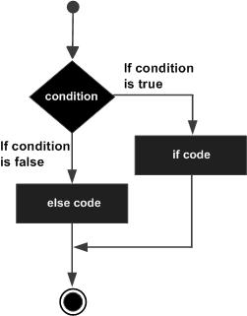
If/else loop

Slide 32
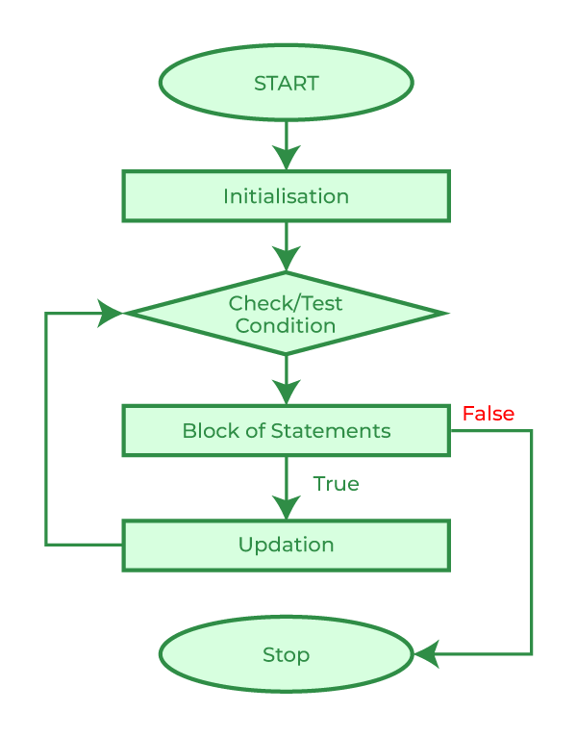
For loop

Slide 33
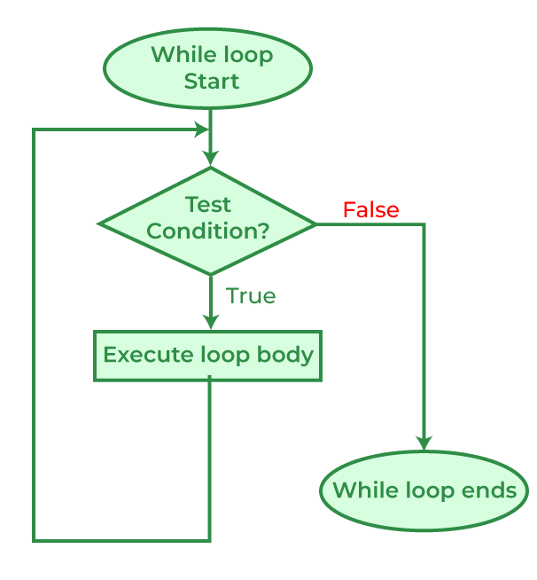
While loop

Slide 34
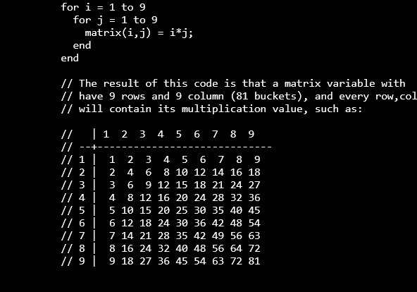
Nested Loops

Slide 35
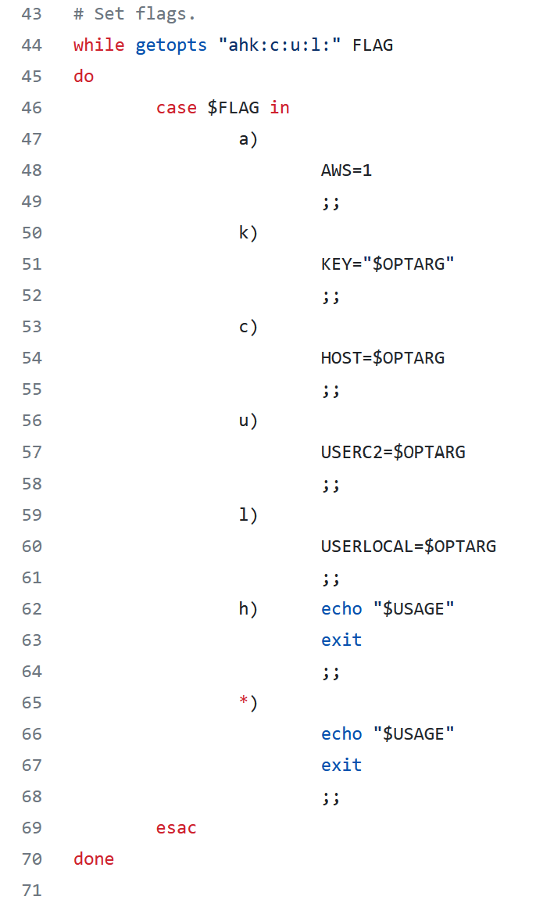
Case statements

Slide 36
Languages
Notes:
Will need to fill this in with some more information later on.

Slide 37

Modern software development concepts
Notes:
Today, we’re going to talk at a high level about how modern software is imagined, developed and delivered. We will get into more specifics on this process when we examine the Software Development Life Cycle, but for now, let’s try to visualize exactly how software construction works.

Slide 38

Why would we make an app?
Notes:
You may be wondering why we would want to use software at all to solve any of our problems. The modern world has turned to software largely because of how versatile it is at solving modern problems. It’s not just about entertainment, it’s about letting technology reduce human toil.

Slide 39

What is the problem?
What problems does this app solve?
How does it solve these problems?

Slide 40

How do we build a quality app?

Slide 41

syntheszing a solution
Notes:
We will need to synthesize the solutions we’ve come up with into an app.

Slide 42

Programming with teams

Slide 43

Leaders & managers
Notes:
Like any other project, there are leaders and managers involved in the process of creating an application. Generally speaking, project leadership make high level design decisions about how an application should function. This of course is only a small part of the puzzle.

Slide 44

Generate requirements

Slide 45

Developers
Notes:
Developers are the lifeblood of executing program design. So when a design choice is made, how that choice gets implemented into the application is passed onto the developers. The “devs” then find the best way of putting the new feature into the program.

Slide 46

Developers work the code

Slide 47

Engineers

Slide 48

Engineers Make Stuff Work

Slide 49

Separation of duties
Notes:
To make all of this work, we need a separation of duties. Separation of duties are important for defining exactly how and where processing happens. We will talk more about this topic when we get deeper into technical explanations, but for now, we should be aware that the specifics of how we process information is important.

Slide 50
10 minute break

Slide 51

Testing
Does the code work?
Does the code work as expected?
Does the code solve the problem we identified?
What does the code work on?
Does the code function with all of our supported systems?
Do we even know what possible systems exist in the field?
Notes:
When we do our testing, we need to ask a few questions about the app’s functionality.

Slide 52

Our Code works!
Now what?

Slide 53

Code distribution

Slide 54
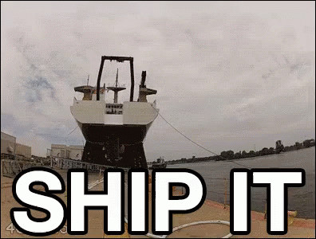
Problem discovery
Notes:
What happens if we discover a problem after we ship the code? What are our options?

Slide 55
Who are our users?
Do we know who they are?
What kind of sensitive information might we be processing?
Personally identifiable information?
HIPAA information?
Legally sensitive?
Notes:
Who are our users? What do they care about? Is there any sensitive information we may be processing that we need to take into account?
Is there a chance that we will run into unforeseen legal governance that will complicate either the way that we process information or store that information.

Slide 56
Supporting those customers
How do our customers contact us?
How do we contact them?
Do we have field support?
What is our process for addressing customer concerns/complains?
What is our process for addressing customer feature requests?
Ticketing system?

Slide 57

Software Development Life Cycle

Slide 58
What is the Software Development Life Cycle?
The SDLC helps us organize the process of building software
Includes steps for building, revising, and deploying software
Includes roles associated with each step along the building process

Slide 59
Why Do We Need An SDLC?
Notes:
We’ve spent two full weeks talking about how software functions, how software can go wrong, and some about how we build software. So by now, it should be obvious that software development is a fairly complicated subject. What we need is a notional concept to fit all of the components of software development into if for no other reason than organization.
For each of the functions of the process of building software, we will have multiple groups with multiple people all working together to create functional applications. This means we have a lot of moving human parts which can be challenging to successfully navigate without a common understanding.

Slide 60
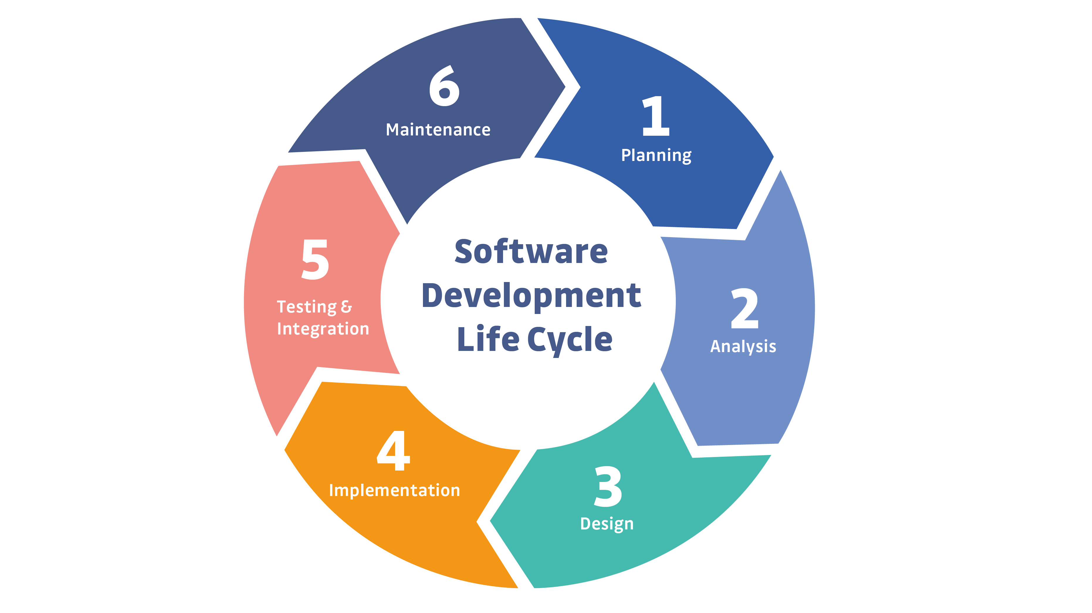
Notes:
This is a simple example of the SDLC. Typically, representations of the SDLC will have around 6 steps, but the steps will generally match what you see here.

Slide 61

More To Come on the SDLC Next Time!

Slide 62
Let’s Make A Github Account
https://github.com

Slide 63

Questions?

Slide 64

Session review

